Slide 1


Personalised Notification Scheduling in ePRO
System: A Privacy-Preserving ML Framework
Ishrat Fatima Syed
ishrat.syed2@mail.dcu.ie
Pooja Balloli
pooja.balloli2@mail.dcu.ie
Supervisor: Prof. Tomás Ward

Slide 2
Introduction
Background
ePRO systems are digital platforms for patients to report symptoms, side effects, and quality of life measures using electronic devices.
They replace traditional paper-based PROs, providing real-time data access for healthcare professionals during clinical trials.
ePRO systems enhance patient engagement, compliance, and data quality through convenient digital data collection.
Vital role in advancing clinical research by providing valuable insights and facilitating remote data collection for more efficient and effective healthcare outcomes.

Slide 3
Introduction (Contd.)
Motivation
A high response rate is critical in ePRO systems for research validity, as incomplete diaries or self-reported data can compromise the accuracy and reliability of study findings.
ePRO systems raise patient trust concerns due to the growing interest of insurance companies in personal data and the persistent threat of data breaches.
Achieving a balance between optimizing response rates and preserving privacy is essential for successful ePRO systems.

Slide 4
Introduction (Contd.)
Objective
In this study, we:
Aim to build an ML model to enhance user response in ePRO systems.
Investigate the feasibility of incorporating a privacy-preserving approach within the ePRO system.
Research Questions
Can we predict a participant’s response to a notification based on the set of features provided?
Can the model’s performance using encoded features match or surpass that achieved without encoded features?
Will this approach preserve privacy and enable dataset augmentation with sensitive participant information, such as age, medical condition, and gender?

Slide 5
Introduction (Contd.)
Dataset
We utilised four diverse datasets, including Installation Data, Research Participant Data, Response Data, and Notification Data, to build a comprehensive foundation for our research
Source: ‘In the Wild Research’
Participants: 350+ individuals
Notifications: 5 times/day
Duration: 24 days
Study Period: 12 weeks
Data Collection: Three cycles of 8 days each
Cycle Gaps: 5 weeks apart
Total Data Points: 832,064
These datasets comprised various features such as app version, device type, participant details, notification responses, and questionnaire configurations.

Slide 6
Literature Review
Designing content-driven intelligent notification mechanisms for mobile applications[1].
Nurture: notifying users at the right time using reinforcement learning[2].
A novel approach for send time prediction on email marketing[3].
The future of digital health with federated learning[4].
Implementing vertical federated learning using autoencoders: Practical application, generalizability, and utility study[5].
Fast deep autoencoder for federated learning[6].

Slide 7
Methodology
Overview of our Approach
Data Collection and Preparation: Gather patient data from ePRO systems, ensuring its quality and relevance.
Autoencoder-based Feature Extraction: Employ autoencoders to encode and extract essential information from participant data.
Participant-Specific Encoding: Create personalized encodings for each participant to capture their unique attributes.
Privacy-Preserving Transformation: Transformed participant data is now encoded representations, protecting privacy.
Model Building: Utilize encoded features to build models for predicting optimal notification times (framed as classification problem) .
Efficiency and Privacy Evaluation: Assess both timely notification effectiveness and data privacy preservation.

Slide 8
Data Cleaning and Preprocessing
Data Cleaning
Conducted a thorough data cleaning process to preprocess and merge four datasets into a unified dataset, ready for analysis.
Managed duplicate records arising from application glitches.
Deleted anomalous records for a specific probe day
Implemented a "Class" column to categorize responses as '1' for those responded and '0' for those not responded.
Through this comprehensive data cleaning process, we effectively reduced the dataset size from 832,064 data points to 26,796 data points.

Slide 9
Data Cleaning and Preprocessing (Contd.)
Data Preprocessing
Categorical Column Handling: Explored two methods, one-hot encoding and label encoding. Implemented Label encoding for categorical columns
Rationale: Autoencoders perform poorly on sparse data often generated by one-hot encoding [7]
Normalisation: Implemented Min-Max scaling for data normalization in our preprocessing strategy.
Rationale: Normalization ensures that features are on the same scale, stabilizing gradient descent, and enabling the use of larger learning rates for quicker model convergence.[8]

Slide 10
Feature Engineering
Limited participant-related attributes, e.g., app version, device type.
Abundant notification-related features, like probe timestamp, engagetimestamp, submittimestamp, and timebased notificationId,.
Enhancing Dataset Context: Calculated supplementary fields: Notification numbers, day notification numbers, and cycles.
Time-Based Features from Probe-Timestamp: Derived probehour, day, month, year, and weekend features to capture temporal aspects of notifications.
Addressing Participant-Related Feature Scarcity: Utilized K-means clustering due to lack of participant-related data.
Determined the total number of responses each participant made in each hour of the day
Clustered participants based on their responses to notifications across different hours of the day

Slide 11
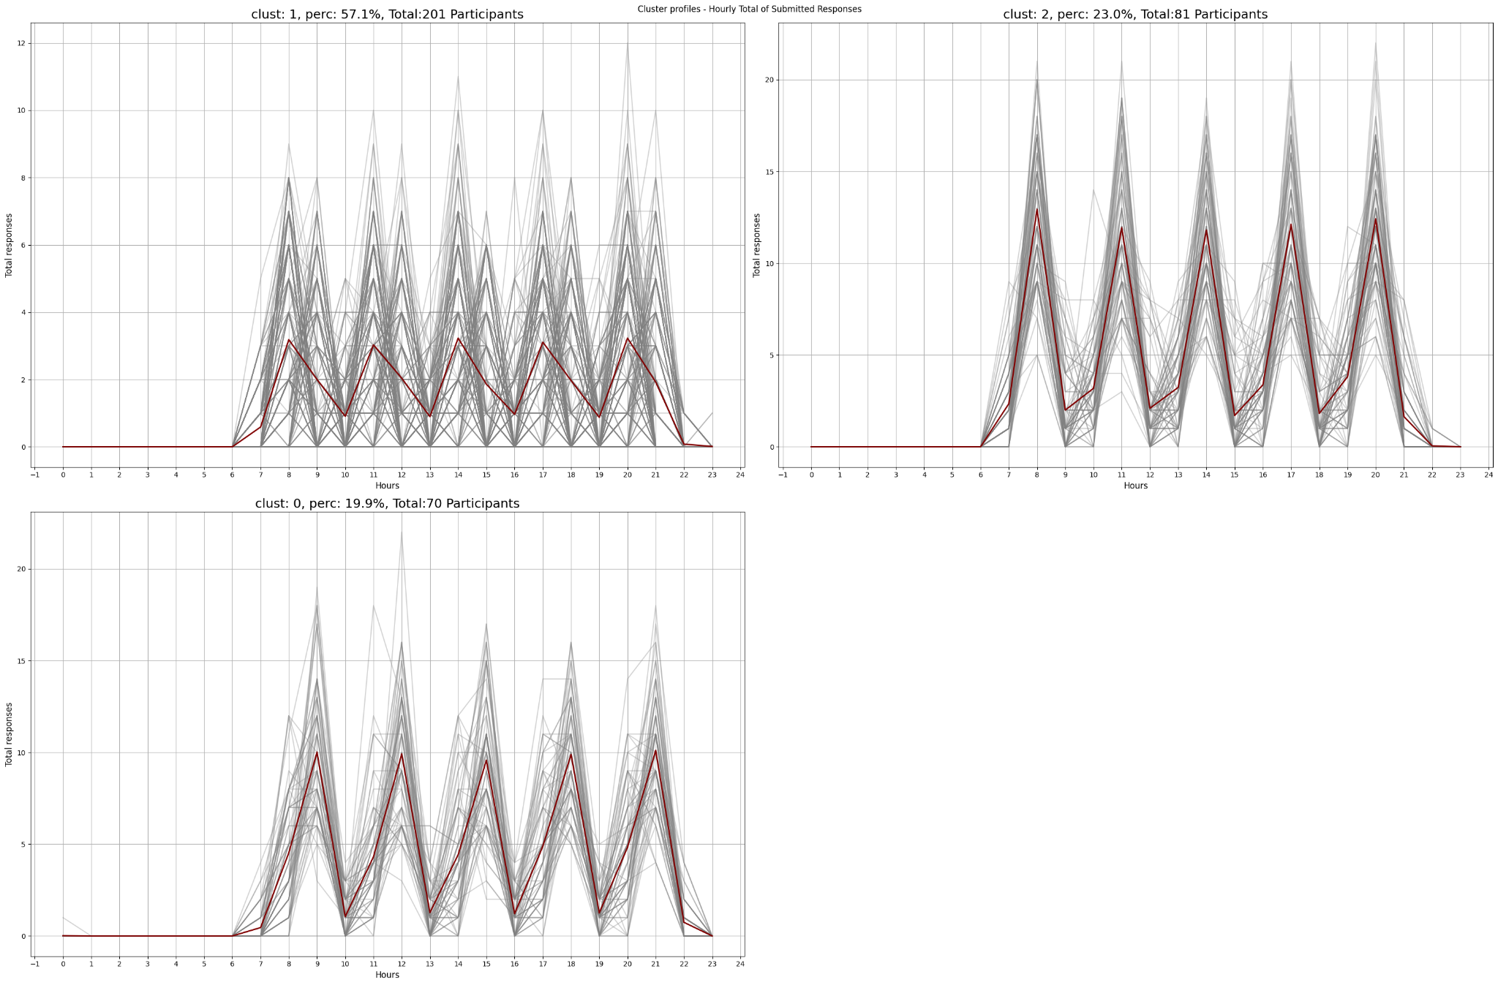
Clustering Results

Slide 12
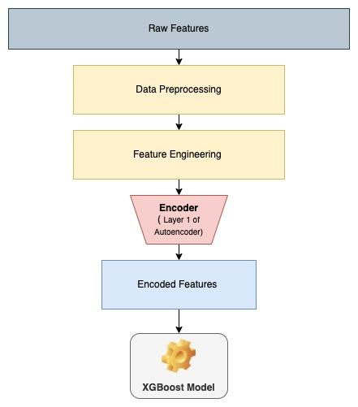
Data Encoding and Privacy preservation
Participant data retained on devices for privacy.
Framework employs autoencoders for encoding.
The latent representation captures personalized interaction patterns with notifications.
Complex encoding thwarts human interpretation, only enables notification sending.
Encoded features serve three main purposes:
Privacy Preservation
Automatic Feature Extraction
Dimensionality Reduction
Approach safeguards privacy, keeps info non-human readable.

Slide 13
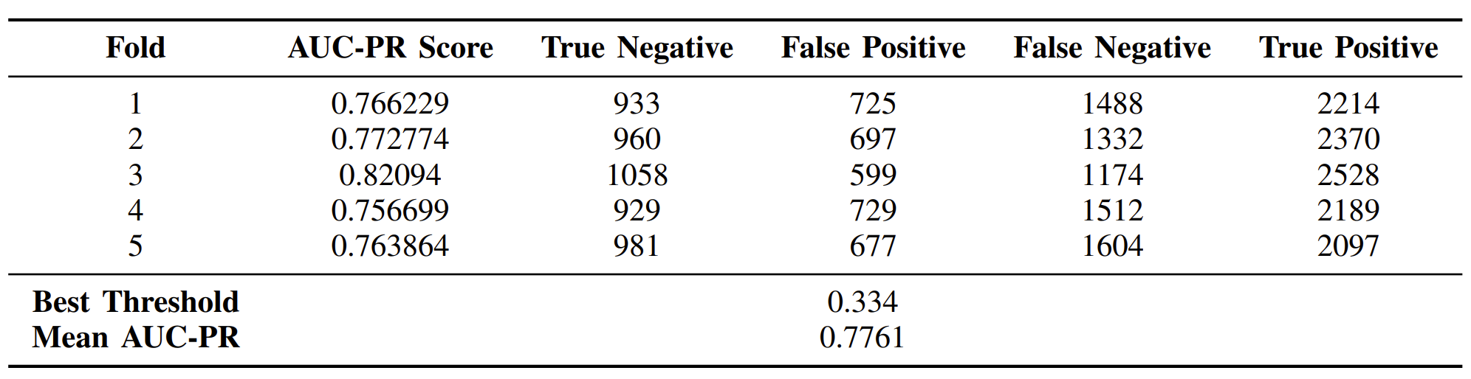
Predictive Modelling
Research question 1:
Can we predict a participant’s response to a notification based on the set of features provided?
Baseline Model 1: Logistic Regression (Raw Features)
Predict participant response to notifications (binary classification)
Addressed class imbalance using class weights parameter
Evaluated using 5-fold cross-validation for robustness
Evaluation Metrics: macro F1, AUC-ROC, AUC-PR
AUC-PR chosen as best evaluation criterion

Slide 14
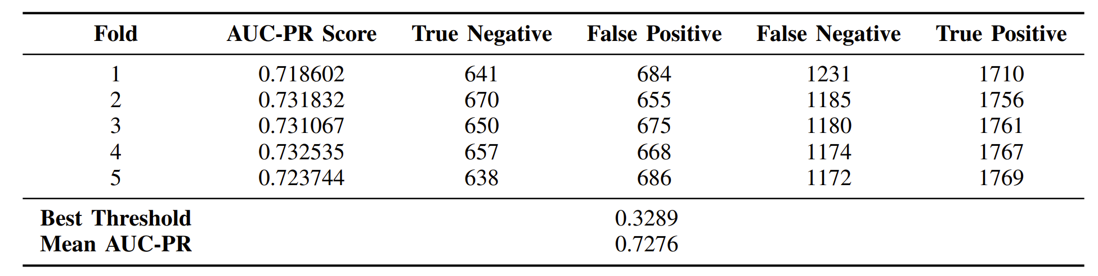
Predictive Modelling (Contd.)
Research question 2:
Can the model’s performance using encoded features match or surpass that achieved without encoded features?
Privacy Preserving Baseline: Logistic Regression (Encoded features)
Predict participant response to notifications (binary classification)
Replaced raw features with encoded features (10 features)
Used same logistic regression model with class weights
Maintained consistent model parameters (as in Baseline Model 1)
Evaluated using 5-fold cross-validation, same test set
Encoded features maintain model performance

Slide 15
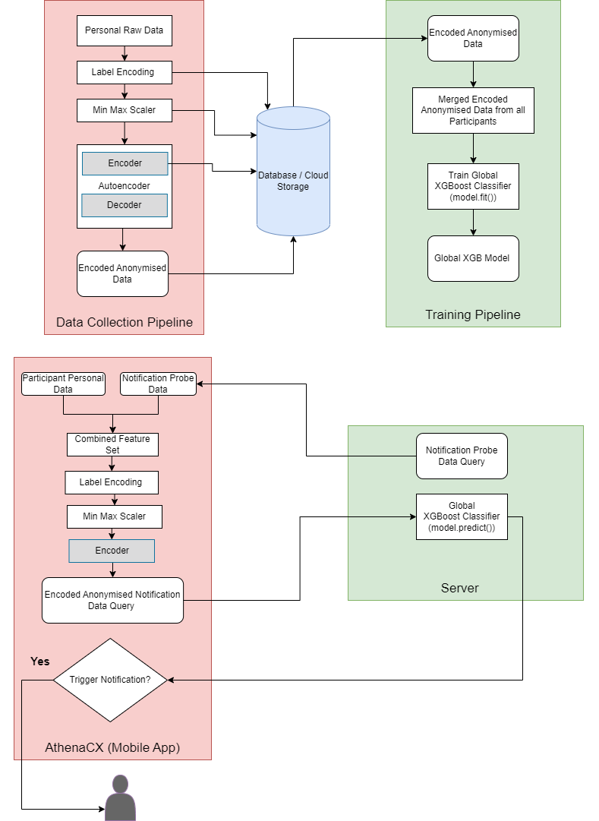
Predictive Modelling (Contd.)
Research question 3:
Will this approach preserve privacy and enable dataset augmentation with sensitive participant information, such as age, medical condition, and gender?

Slide 16
Challenges Faced
Lack of participant specific features.
Inadequate training data per participant.
Imbalanced dataset.
Autoencoders struggled to learn and reconstruct rare features of the minority class in imbalanced datasets, resulting in subpar performance for these instances

Slide 17
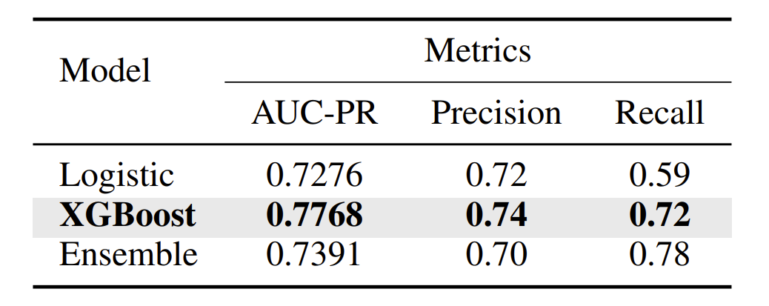
Result
Three models explored: logistic regression, XGBoost, and an ensemble model comprising seven classifiers
Stratified 5-fold cross-validation adopted, considering dataset skewness and the objective of correctly identifying responders (positive class)
Area Under the Precision-Recall Curve (AUC-PR) chosen as evaluation metric due to dataset imbalance
XGBoost identified as top-performing model after thorough experimentation and hyperparameter tuning
Model robustness evaluated through "cold start" scenarios, testing performance on new participants
Model exhibited favorable performance on new participants, achieving AUC-PR of 0.728.
Notable decrease in precision for the negative class observed, indicating challenges in distinguishing non-responders among new participants.
Notes:
DecisionTreeClassifier, RandomForestClassifier, GradientBoostingClassifier, SVC, KNeighborsClassifier, LogisticRegression, GaussianNB

Slide 18
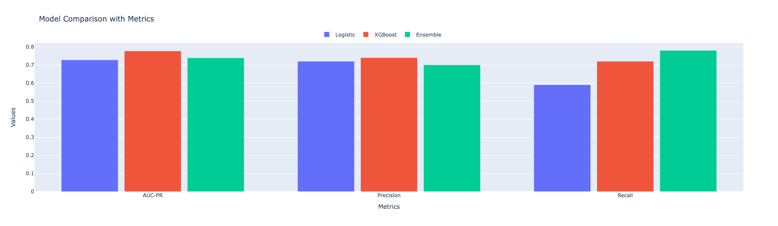
Result
Comparison of models : XGBoost Outperforms all models
Kruskal-Wallis Test: Is the Result Real or Just a Coincidence?
Null hypothesis (H₀): There is no significant difference between the performance (AUC-PR) of the compared models.
Kruskal-Wallis Test Outcome:
Observed p-value: 0.003
Conclusion: There is a statistically significant difference among model performances.

Slide 19
Conclusion
In conclusion, we demonstrated :
Machine learning models can be used to find the optimal times to send notifications to users, which can improve user engagement with notifications.
A novel use of autoencoders to protect ePRO system privacy by one-way encoding sensitive participant data.
Machine learning models effectively learn patterns from both encoded and unencoded features, maintaining comparable performance levels.
that the privacy of participant data can be protected while still building a personalized ML model to find optimal notification times. This principle applies to any classification model.
alternative to "Federated Learning" for on-device model training, ensuring participant/user data remains decentralized on edge devices.

Slide 20
Future Work
Test Robustness to 'Model Poisoning'[9]
Explore Advanced Models
RFM Analysis
Longitudinal Study Expansion
Separate Autoencoders for Majority and Minority Classes
Targeted Enhancement through Error Analysis

Slide 21
References
A. Mehrotra, M. Musolesi, R. Hendley, and V. Pejovic, “Designing content-driven intelligent notification mechanisms for mobile applications,” in Proceedings of the 2015 ACM International Joint Conference on Pervasive and Ubiquitous Computing, pp. 813–824, 2015.
B.-J. Ho, B. Balaji, M. Koseoglu, and M. Srivastava, “Nurture: notifying users at the right time using reinforcement learning,” in Proceedings of the 2018 ACM International Joint Conference and 2018 International Symposium on Pervasive and Ubiquitous Computing and Wearable Computers, pp. 1194–1201, 2018
C. Araujo, C. Soares, I. Pereira, D. Coelho, M. ´ A. Rebelo, and ˆ A. Madureira, “A novel approach for send time prediction on email marketing,” Applied Sciences, vol. 12, no. 16, p. 8310, 2022
N. Rieke, J. Hancox, W. Li, F. Milletari, H. R. Roth, S. Albarqouni, S. Bakas, M. N. Galtier, B. A. Landman, K. Maier-Hein, et al., “The future of digital health with federated learning,” NPJ digital medicine, vol. 3, no. 1, p. 119, 2020
D. Cha, M. Sung, Y.-R. Park, et al., “Implementing vertical federated learning using autoencoders: Practical application, generalizability, and utility study,” JMIR medical informatics, vol. 9, no. 6, p. e26598, 2021.
D. Novoa-Paradela, O. Fontenla-Romero, and B. Guijarro-Berdinas, ˜ “Fast deep autoencoder for federated learning,” Pattern Recognition, p. 109805, 2023.
Building Autoencoders on Sparse, One Hot Encoded Data
Using Normalization Layers to Improve Deep Learning Models
E. Bagdasaryan, A. Veit, Y. Hua, D. Estrin, and V. Shmatikov, “How to backdoor federated learning,” CoRR, vol. abs/1807.00459, 2018.

Slide 22
Questions
Questions?

